Slide 1




DUY TAN UIVERSITY
INTERNATIONAL SCHOOL
COURSE: CMU-CS 426 - CLASS: BIS
INFORMATION WARFARE
DUAL THREAT ANALYSIS:
EMAIL EXPLOITS AND RCE ATTACKS
Instructor: MSc. Nguyen Trung Thuan
GROUP NO.4 - Group members:
Tran Van Duc – Team Leader
Chu Van An – Member
Luong Vu Anh Nga – Member
Tran Thi Thanh Thuy – Member
Dang Ngoc Xuan Tri – Member
SEMESTER: 2 – YEAR 2023-2024

Slide 2

Control attack scenario (RCE)
Introduction
attack models
CONTENT
defense measures
Email attack scenario
Introduction
attack models
defense measures

Slide 3


INTRODUCTION TO RCE

Slide 4
An introduction to RCE
Remote Code Execution (RCE): is a network attack technique of hackers that relies on a vulnerability or vulnerability of the system to remotely access the victim's computer or computer network.

Slide 5
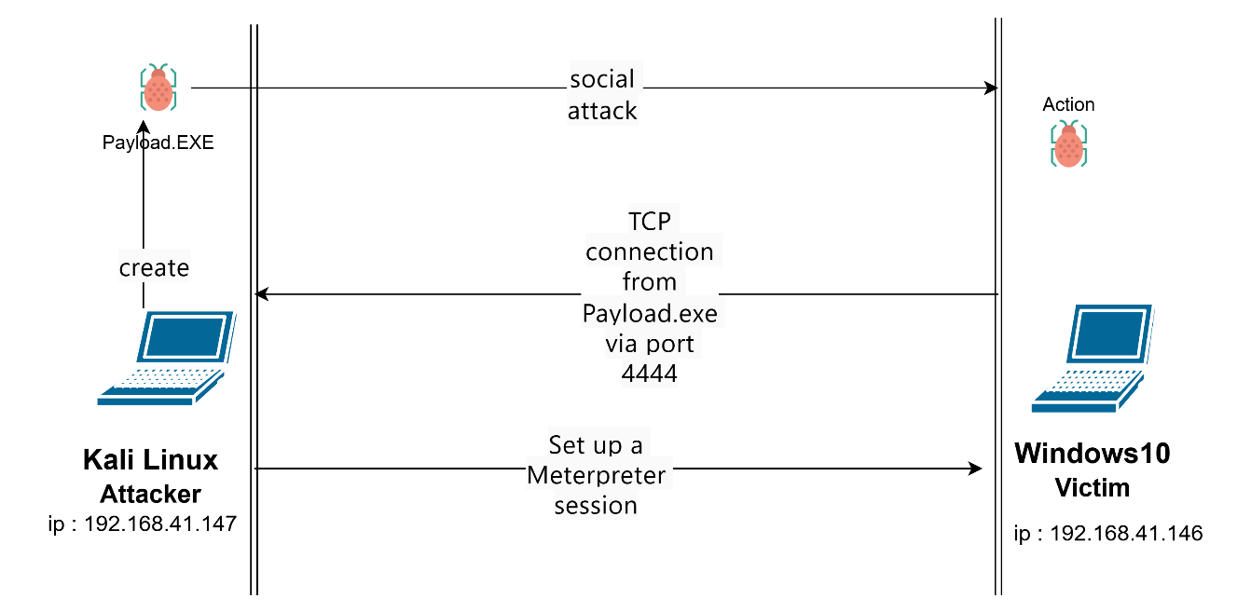
ATTACK MODEL

Slide 6
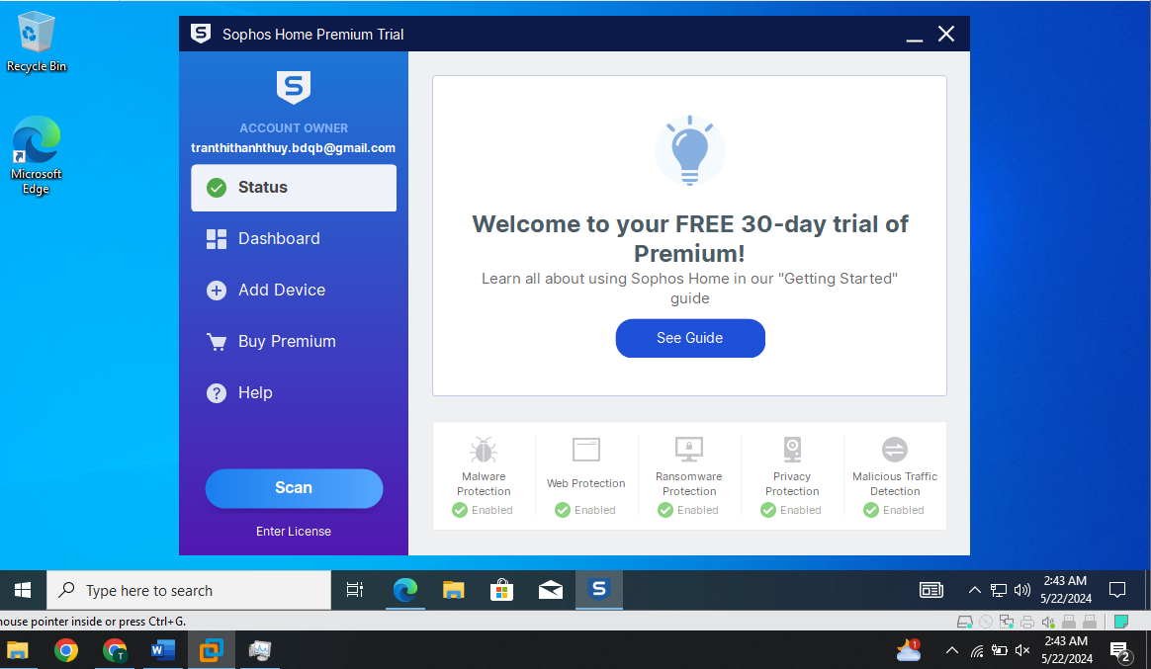
PREVENTIVE MEASURES
Install IDA (decompilation analysis tool).
Go to the ida homepage, install ida about. There are many versions of IDA. For the paid version it has more features and tools, better serving the installation process.
Install Sophos Home.

Slide 7
INTRODUCTION TO PHiSHING

Slide 8



INTRODUCTION TO PHiSHING
This is the most common attack method via email. Attackers spoof emails from trusted organizations such as banks, financial services, or technology companies to trick users into providing personal information

Slide 9

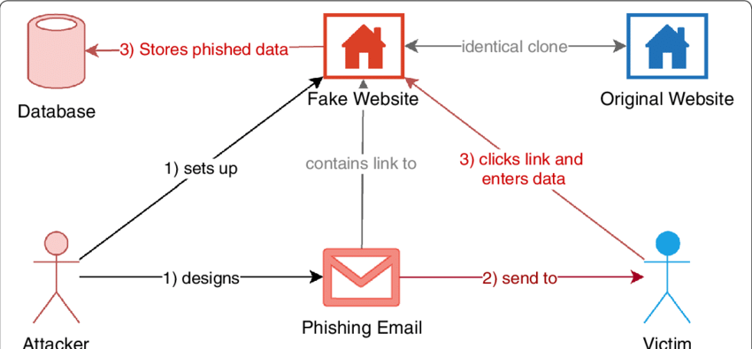
Model Attack
VISION

Slide 10


PHISHING PRVENTION MEASURES
- Enable Two-Factor Authentication (2FA) - Carefully Check Sender Email Addresses - Avoid Clicking on unfamililar Links - Be Wary of Requests for personal information - Use security software

Slide 11
Demo

Slide 12
Thank
You

